Slide 1
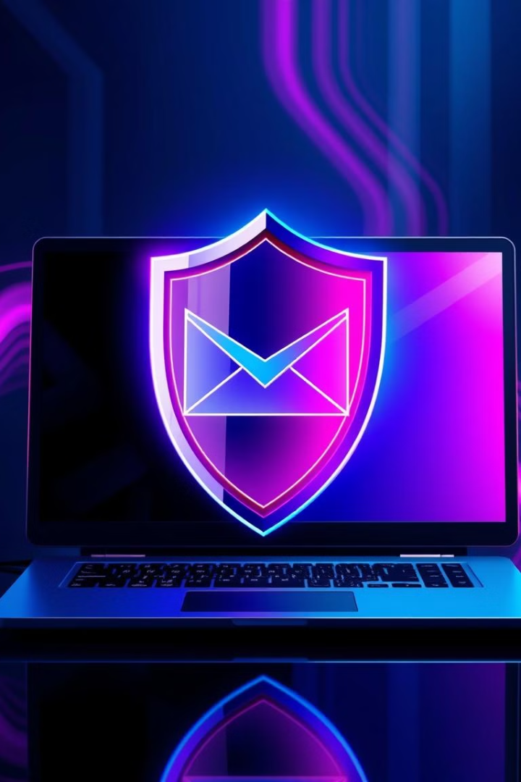
Phishing Awareness Training: Protect Yourself from Cyber Threats
Welcome to the Phishing Awareness Training program! This training is designed to equip you with the knowledge and skills necessary to protect yourself and your organization from cyber threats, specifically phishing attacks. By understanding what phishing is, how it works, and what to look for, you can significantly reduce your risk of falling victim to these scams. Let's get started and learn how to stay safe online.

Slide 2
Introduction to Phishing
Definition
Importance of Awareness
Real-World Examples
Phishing is a type of cyber attack where criminals attempt to trick individuals into revealing sensitive information, such as usernames, passwords, credit card details, or other personal data, by disguising themselves as trustworthy entities.
Phishing awareness is crucial because these attacks are becoming increasingly sophisticated and prevalent. By understanding the tactics used by phishers, you can better protect yourself and your organization from potential harm.
Phishing attacks can take many forms, such as fake emails from banks, fraudulent social media messages, or deceptive phone calls. These attacks often lead to financial loss, identity theft, and reputational damage.

Slide 3
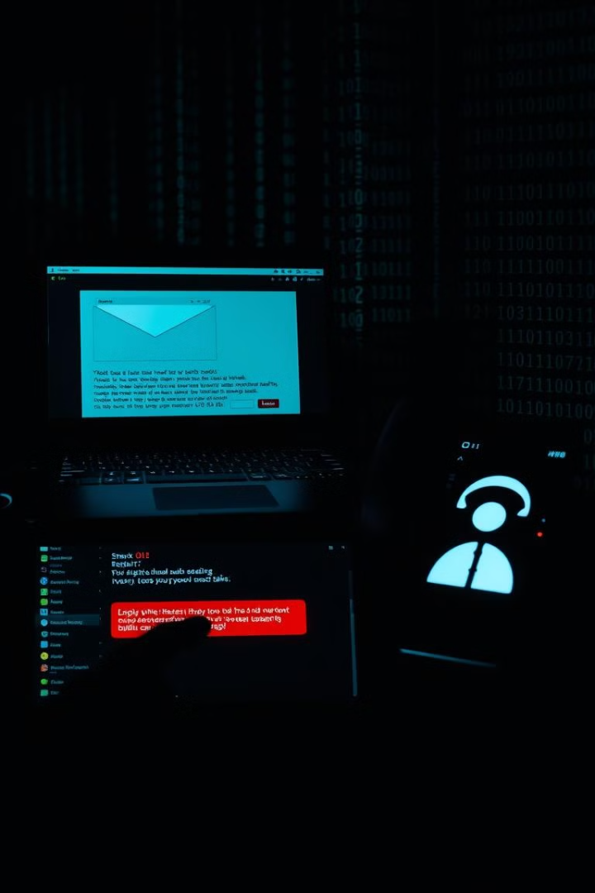




Types of Phishing Attacks
Email Phishing
Fake emails pretending to be from trusted sources, such as banks or popular websites, are used to trick victims into clicking malicious links or providing personal information.
Spear Phishing
Targeted attacks on specific individuals or organizations, often using personalized information to increase credibility and success rates.
Smishing (SMS Phishing)
Fake messages sent via text or mobile apps, designed to lure victims into revealing sensitive data or downloading malware.
Vishing (Voice Phishing)
Scam calls to trick victims into sharing sensitive information over the phone, often using urgency or threats to pressure individuals.

Slide 4

Recognizing Phishing Emails
Unusual Sender Addresses
Urgent Language
Phishing emails often use urgent or threatening language to pressure you into taking immediate action without thinking.
Be wary of emails from unfamiliar or suspicious sender addresses that don't match the supposed organization's domain.
Suspicious Links/Attachments
Hover over links before clicking to check their destination. Avoid opening attachments from unknown senders.

Slide 5
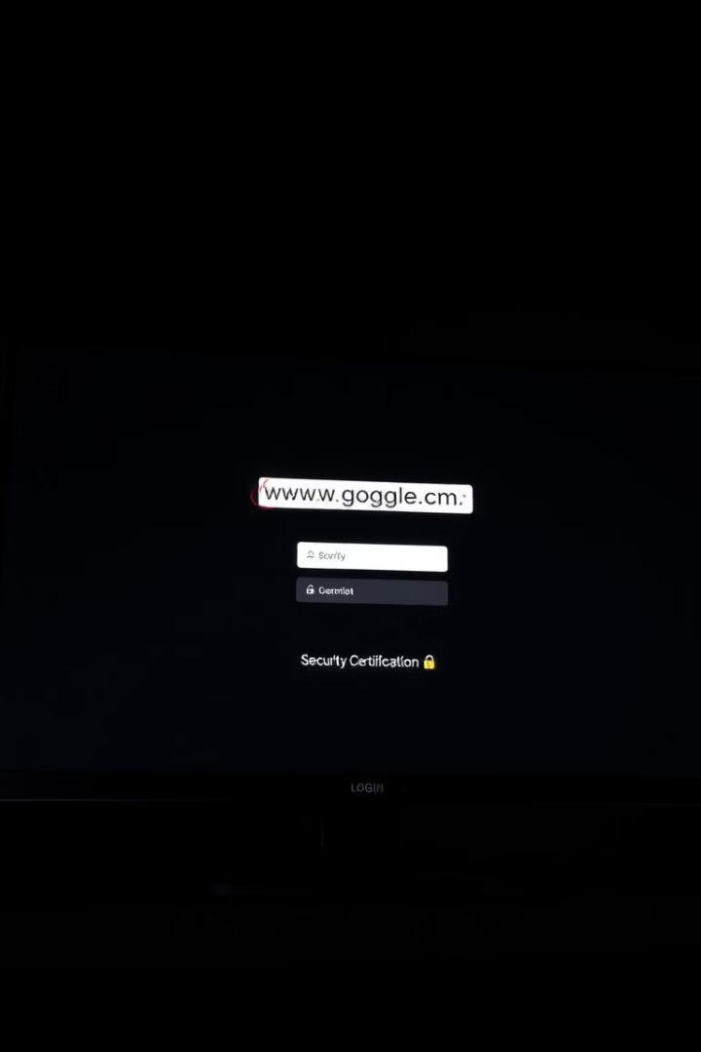



Identifying Phishing Websites
Check the URL
Look for misspellings or extra characters in the URL, as phishers often create fake sites with similar-looking addresses.
HTTPS and Certificate
Ensure the website uses HTTPS and has a valid security certificate, indicated by a padlock icon in the address bar.
Beware of Fake Pages
Be cautious of fake login pages that mimic real sites, as they are designed to steal your credentials.

Slide 6



Social Engineering Tactics
Psychological Manipulation
They use psychological manipulation, such as urgency, fear, or curiosity, to trick you into acting impulsively.
2
Impersonation
Phishers often impersonate trusted individuals, such as colleagues, supervisors, or IT staff, to gain your trust.
1
Pretexting
Phishers may use a fake scenario or pretext to gather information from you, such as pretending to be conducting a survey or offering a prize.
3

Slide 7
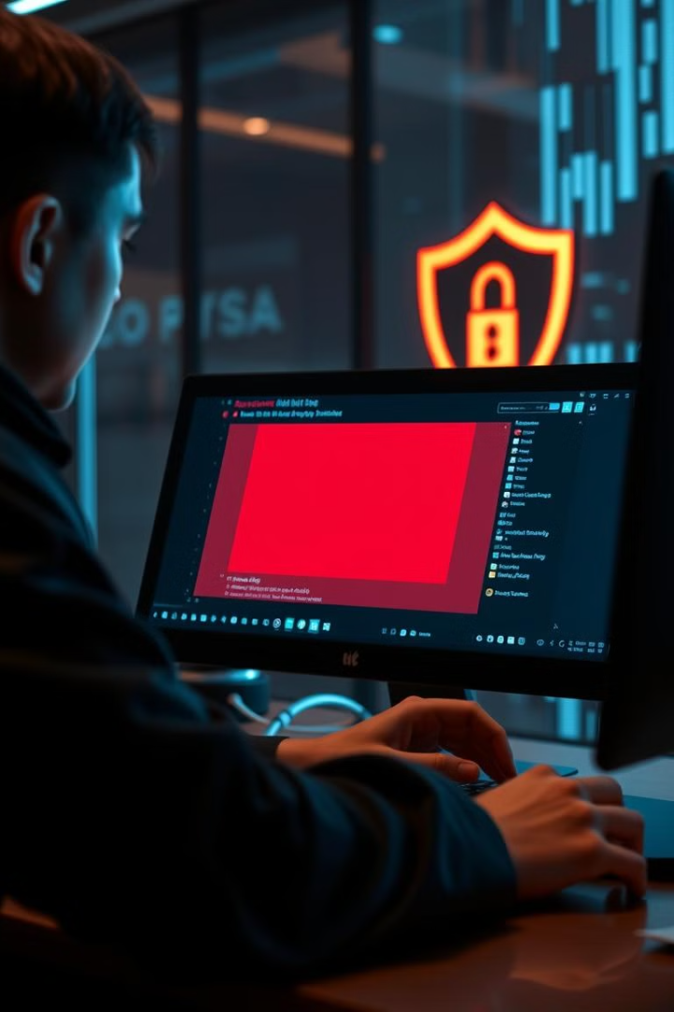




Best Practices to Avoid Phishing Attacks
Think Before You Click
Verify the Sender
Enable MFA
Hover over links before clicking to verify their destination. Be cautious of suspicious or shortened URLs.
Contact the sender through official channels to confirm the legitimacy of the email or message.
Enable Multi-Factor Authentication (MFA) for extra security on your accounts.
Keep Software Updated
Keep your software and antivirus updated to protect against known vulnerabilities.

Slide 8
Conclusion & Next Steps
Key Takeaways
1
Remember the key signs of phishing and stay vigilant.
Ongoing Vigilance
2
Cyber threats are constantly evolving, so stay informed and proactive.
Report Suspicious Emails
3
Report any suspicious emails or messages to your IT or security teams.
By staying informed, practicing safe online habits, and reporting suspicious activity, you can play a crucial role in protecting yourself and your organization from cyber threats. Thank you for participating in this training program. Stay safe online!

